Slide 1
IBM Advanced Data Science Capstone Project COVID-19 Predictions

Slide 2
COVID-19
In COVID-19,
'CO' stands for 'corona‘
'VI' for 'virus’
and 'D' for disease
Formerly, this disease was referred to as “2019 novel coronavirus” or “2019-nCoV”, This Started in Wuhan, China.
Coronaviruses are members of the coronavirus family of viruses — one of the many families that include viruses able to infect people and animals. Seven members of the coronavirus family can make people ill, one of which is the new coronavirus strain SARS-CoV-2 (Severe Acute Respiratory Syndrome), which causes COVID-19.

Slide 3
COVID-19 Predictions
a) the data set : For this Project I’m using John Hopkins University Github dataset. Files from folder csse_covid_19_time_series
time_series_covid19_confirmed_global.csv
time_series_covid19_deaths_global.csv
time_series_covid19_recovered_global.csv
csse_covid_19_daily_reports
b) the use case : Predicting the Coronavirus COVID-19 confirmed cases for World and US by using Sequential Model. Show visualizations with Table data and Graphs
c) the solution to the use case : My Solution is presented in PowerPoint and it is in notebook.

Slide 4
COVID-19 Predictions
a) Architectural choices :
I have used IBM Watson Studio : Jupyter notebook for the below components.
ETL
Model definition
Model Training
b) data quality assessment
Poor data quality is hindering organizations from performing to their full potential. This is where machine learning assumes its crucial role.
Missing values
Duplicate values
data pre-processing : data gets transformed, or Encoded, to bring it to such a state that now the machine can easily parse it. In other words, the features of the data can now be easily interpreted by the algorithm.

Slide 5
COVID-19 Predictions
Feature Aggregation
aggregated values in order to put the data in a better perspective.
This results in reduction of memory consumption and processing time
Aggregations provide us with a high-level view of the data as the behaviour of groups or aggregates is more stable than individual data objects
Graphs in this Project
shows the data by number of Days.
shows the confirmed cases by top 10 Country, States

Slide 6
COVID-19 Predictions
c) Model performance indicators :
MAE (Mean Absolute Error) : is the average of the difference between the Original Values and the Predicted Values. It gives us the measure of how far the predictions were from the actual output.
MSE (Mean Squared Error) : takes the average of the square of the difference between the original values and the predicted values. The advantage of MSE being that it is easier to compute the gradient
d) Model algorithm : I used Sequential Model algorithms for COVID-19 Predictions.
SVM (Support Vector Machine)
Polynomial Regression

Slide 7
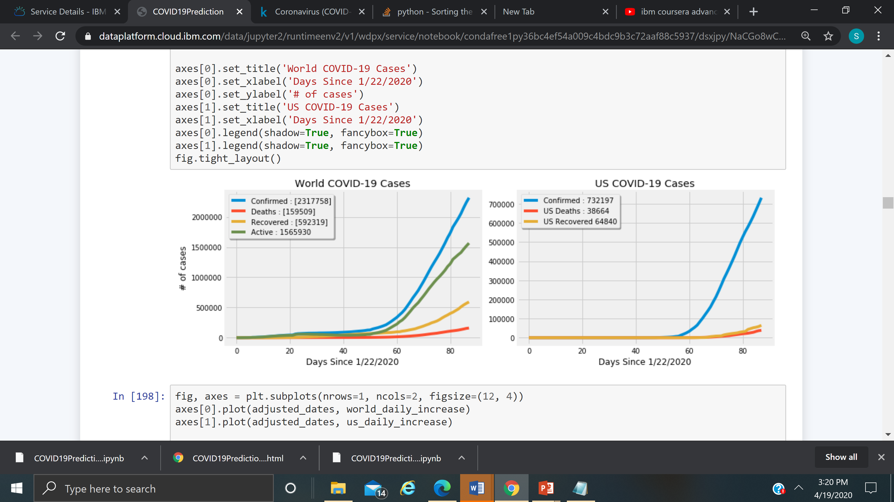
COVID-19 Predictions : Cases by World, US

Slide 8
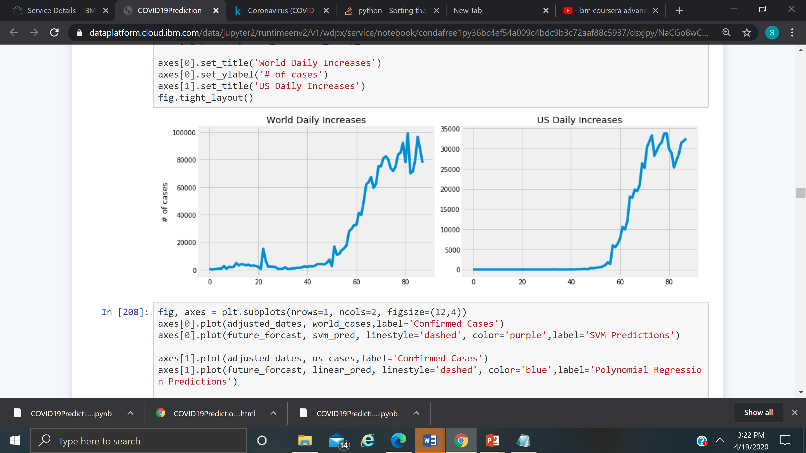
COVID-19 Predictions : Daily Increase Cases by Days

Slide 9
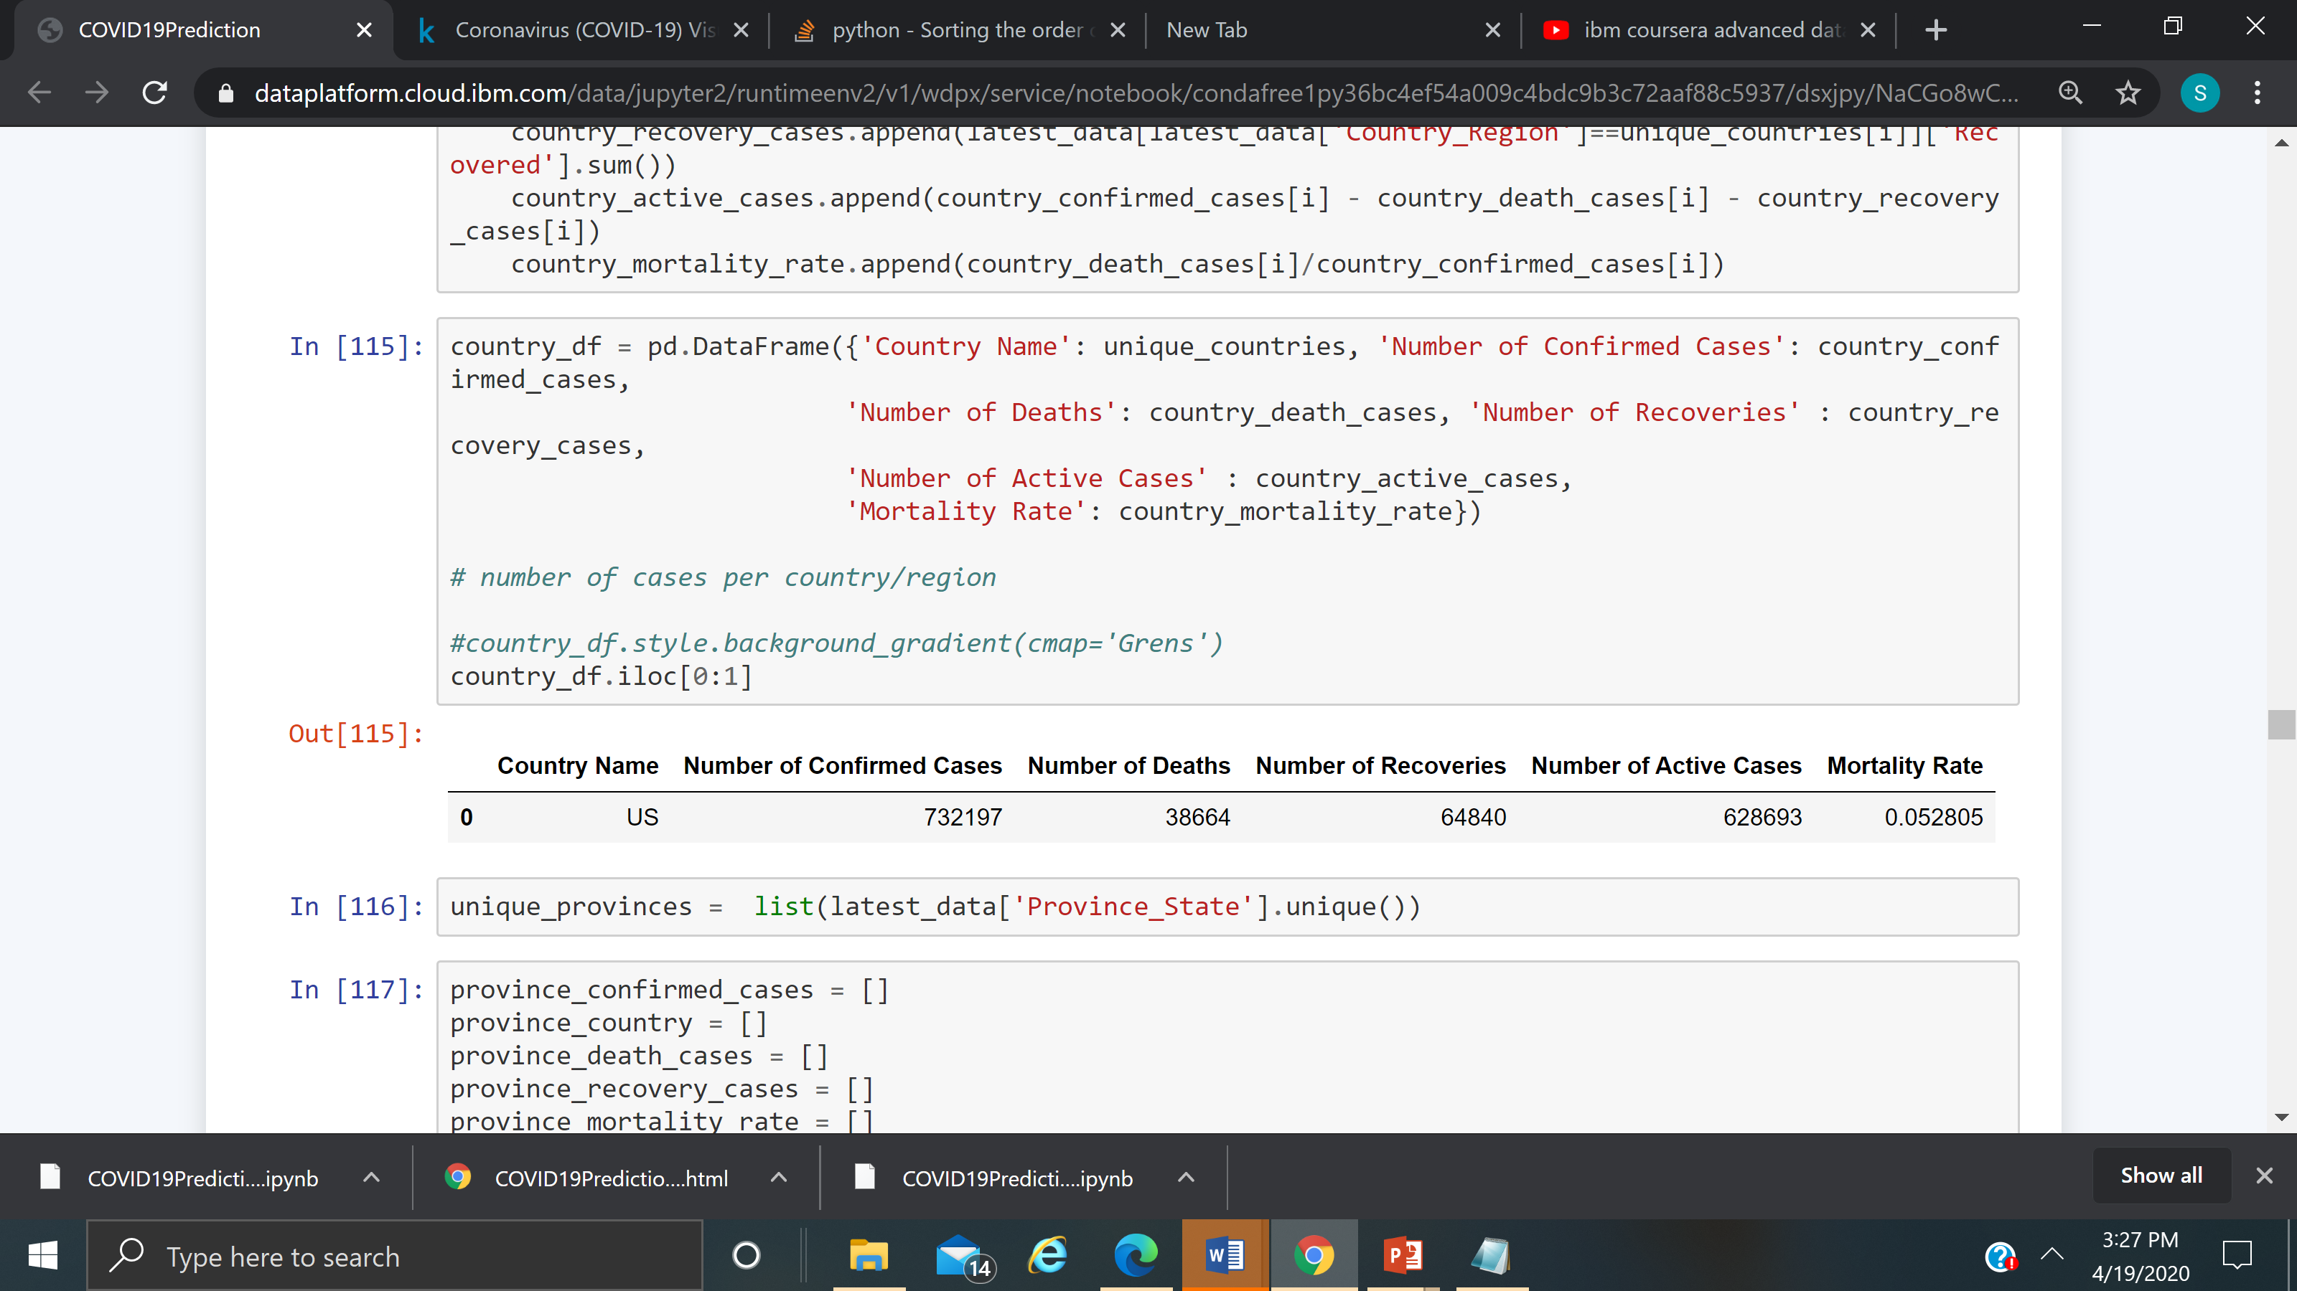
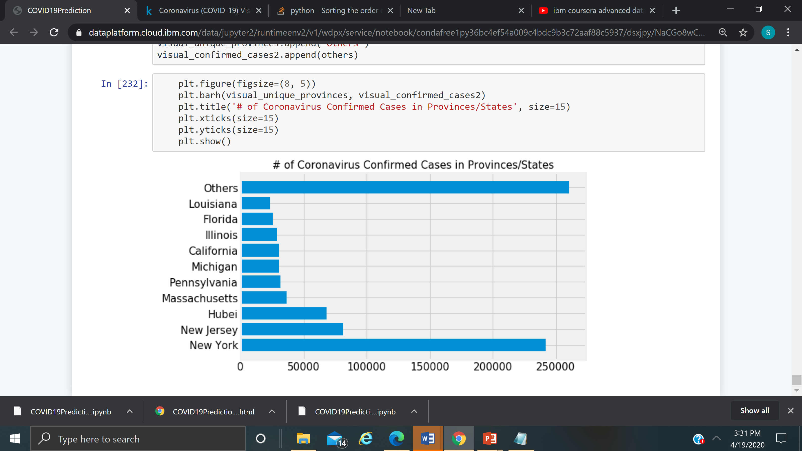
COVID-19 Predictions : US cases in the top

Slide 10
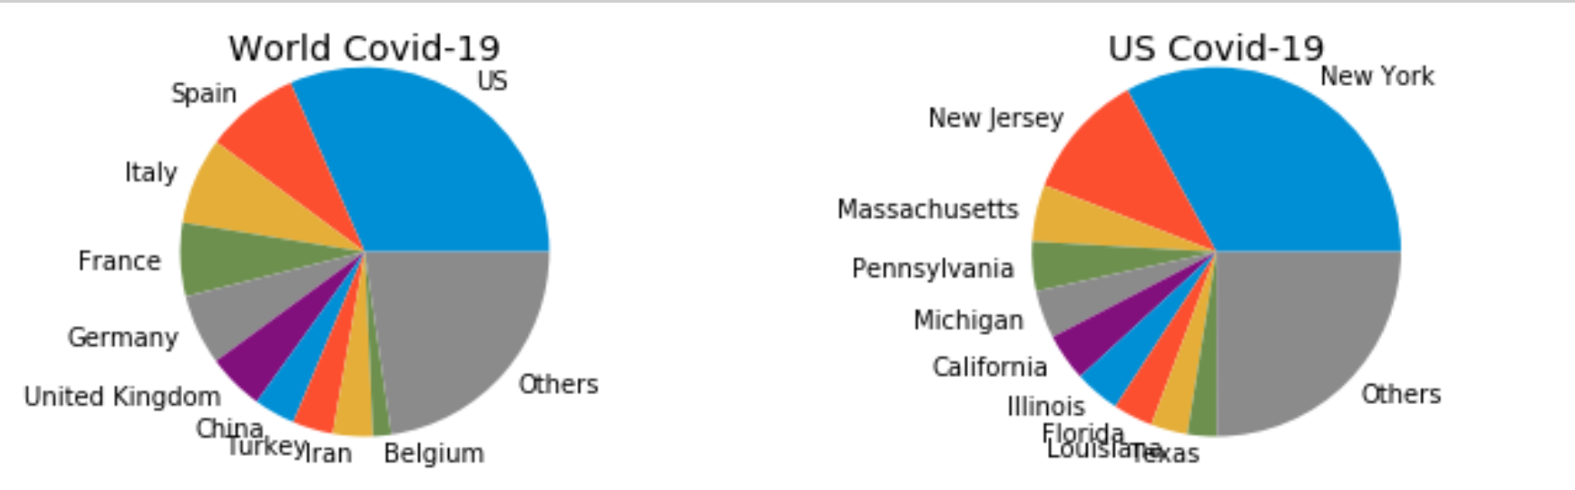
COVID-19 Predictions : Chart by top 10 World, US

Slide 11
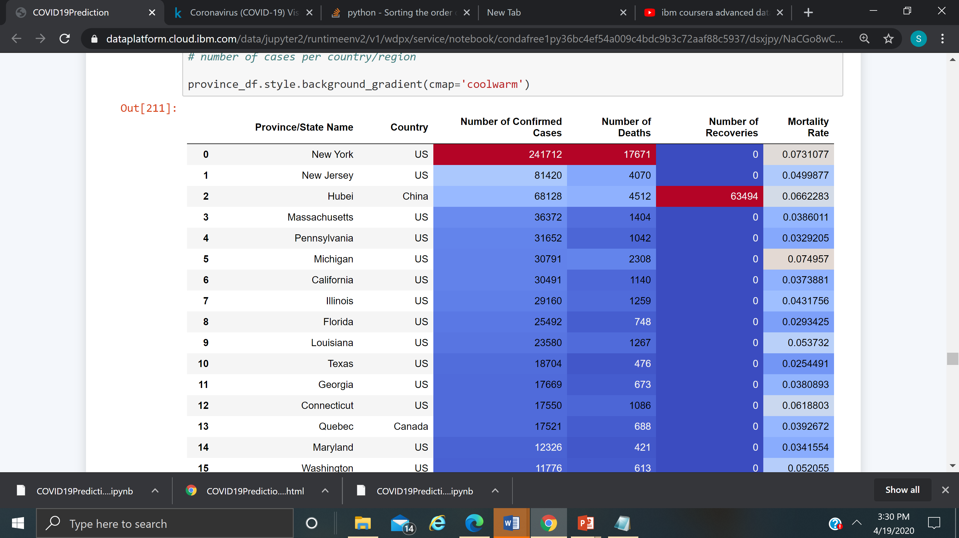
COVID-19 Predictions : Data by Province/State

Slide 12
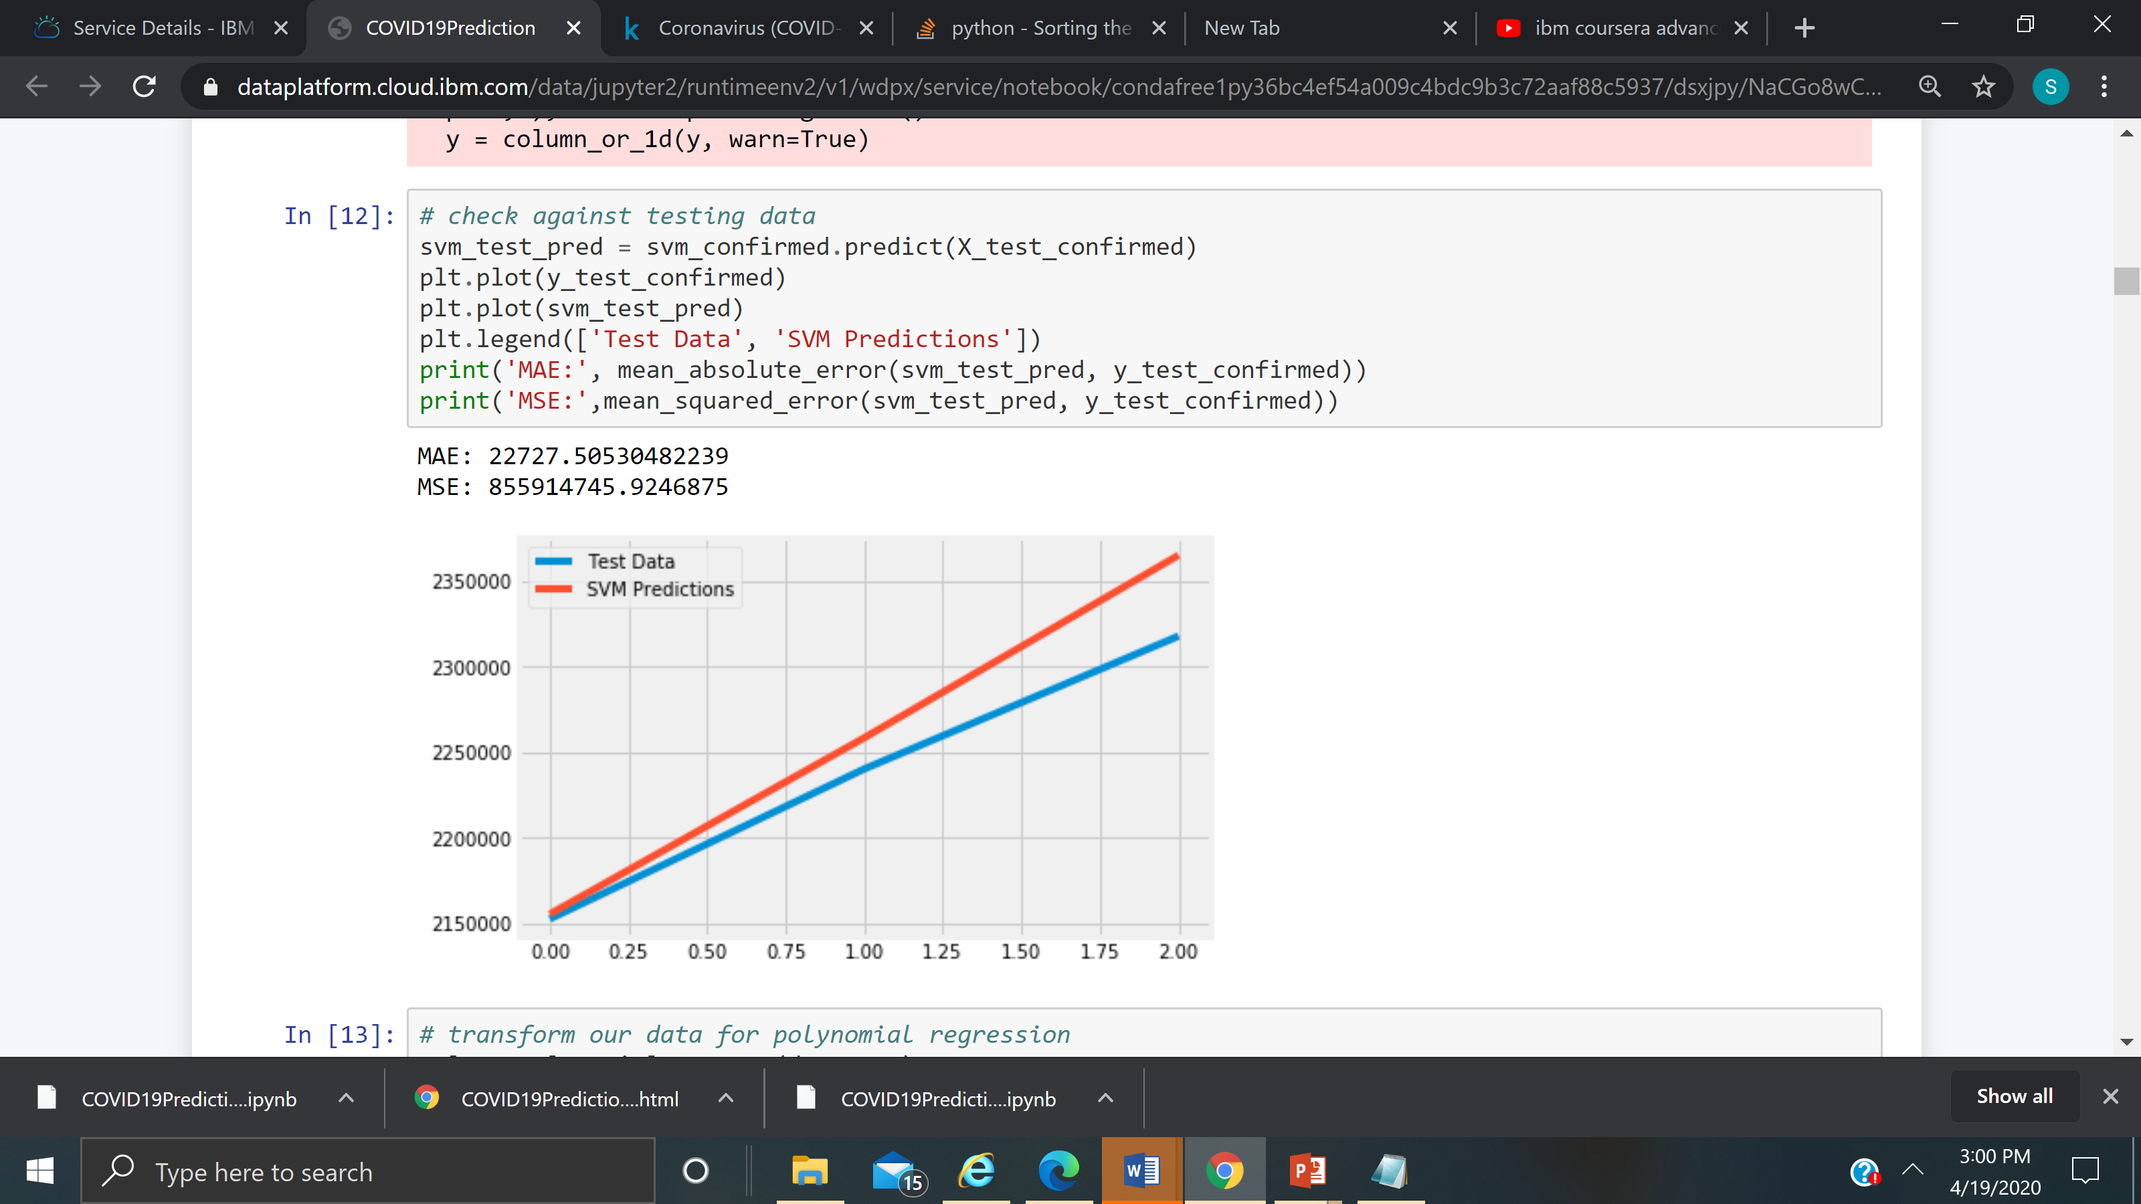
COVID-19 Predictions : SVM In machine learning, support-vector machines are supervised learning models with associated learning algorithms that analyze data used for classification and regression analysis.

Slide 13
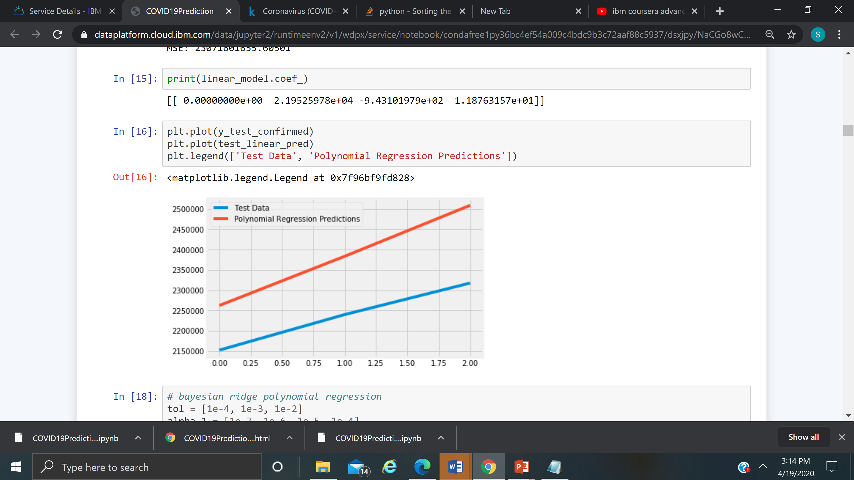
COVID-19 Predictions : Polynomial Regression original features are converted into Polynomial features of required degree (2,3,..,n) and then modeled using a linear model."
MAE: 148174.50781263752 MSE: 23071601655.60501
MAE: 148174.50781263752
MSE: 23071601655.60501

Slide 14
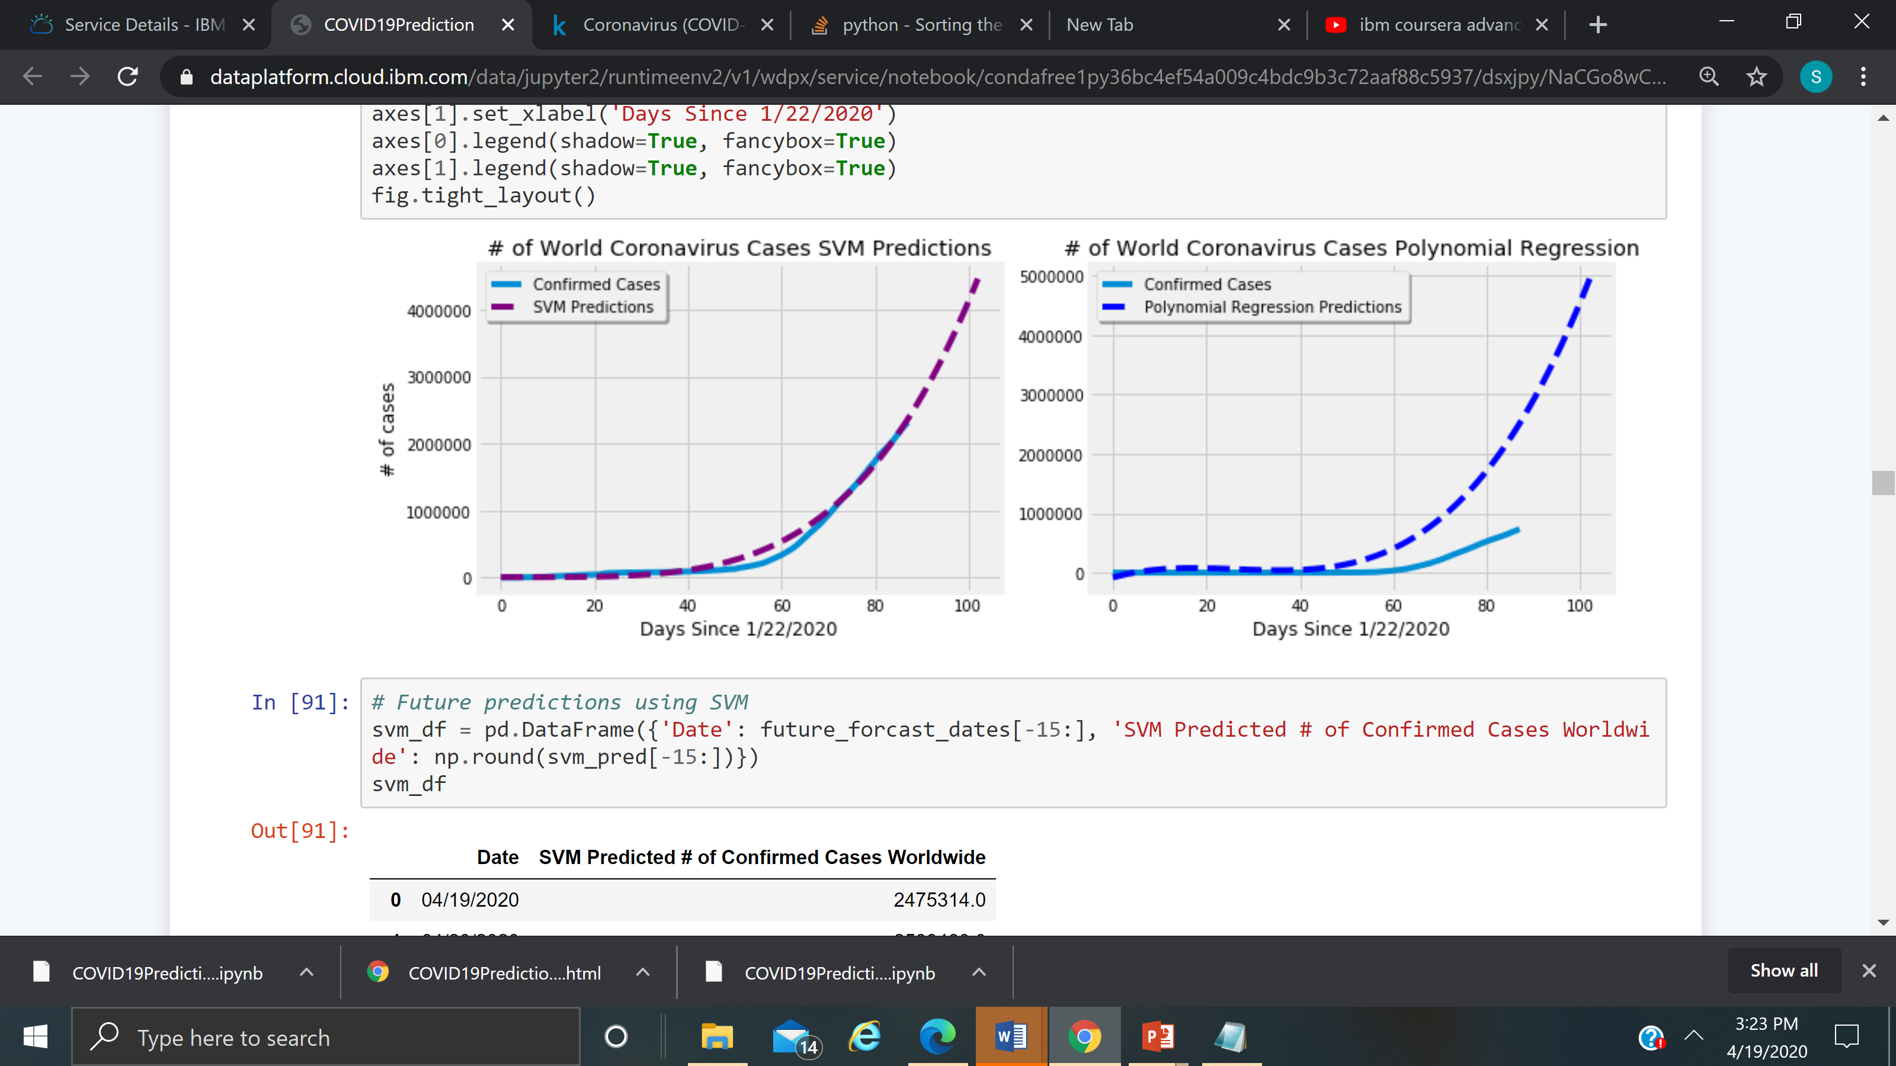
COVID-19 Predictions : Confirmed cases vs SVM or Polynomial Regression

Slide 15
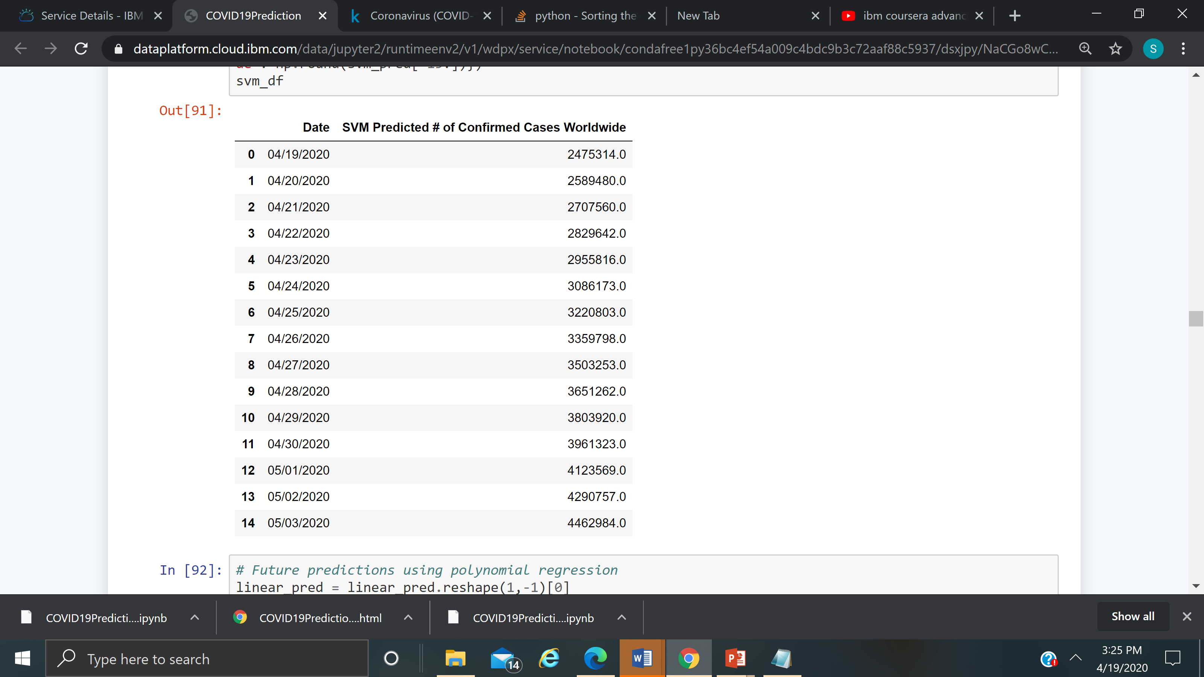
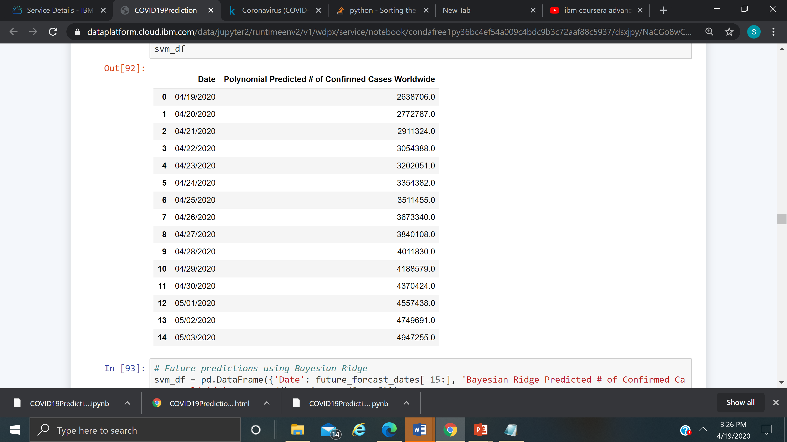
COVID-19 Predictions : SVM vs Polynomial by day

Slide 16
Prevention : Protect yourself and others around you by knowing the facts and taking appropriate precautions. Follow advice provided by your local public health agency.
Protect yourself and others around you by knowing the facts and taking appropriate precautions. Follow advice provided by your local public health agency.
To prevent the spread of COVID-19:
Clean your hands often. Use soap and water, or an alcohol-based hand rub.
Maintain a safe distance from anyone who is coughing or sneezing.
Don’t touch your eyes, nose or mouth.
Cover your nose and mouth with your bent elbow or a tissue when you cough or sneeze.
Stay home if you feel unwell.
If you have a fever, a cough, and difficulty breathing, seek medical attention. Call in advance.
Follow the directions of your local health authority.
Avoiding unneeded visits to medical facilities allows healthcare systems to operate more effectively, therefore protecting you and others.

Slide 17
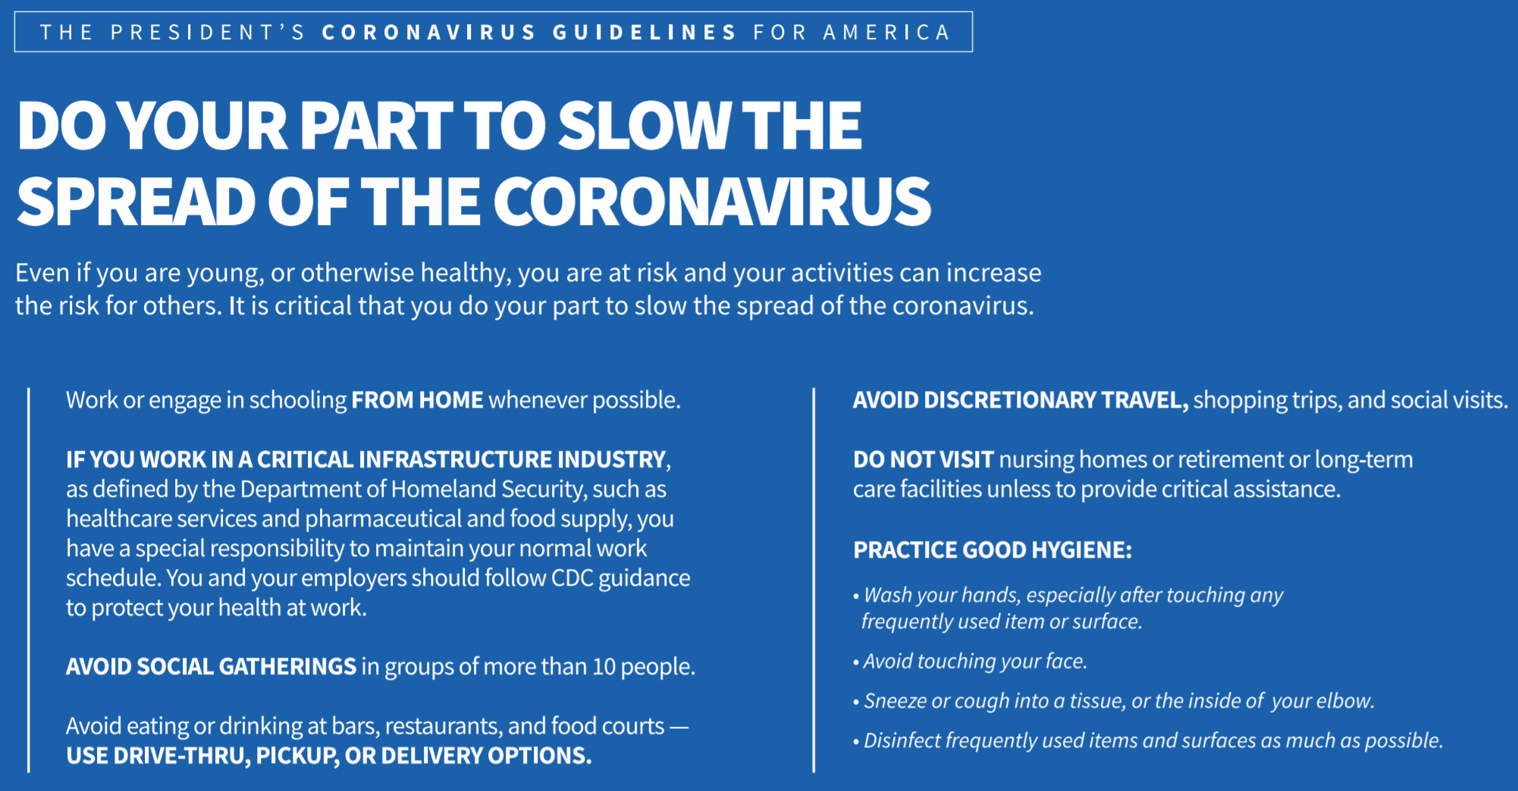

Slide 18
Acknowledgements
I would like to acknowledge Johns Hopkins University for open-sourcing their dataset. Their dataset is transformed into a format that is easier for IBM Watson Jupyter notebook to handle.
I would like to thank my instructor Romeo Kienzler for teaching Coursera classes on Advanced Machine Learning.

